Slide 1
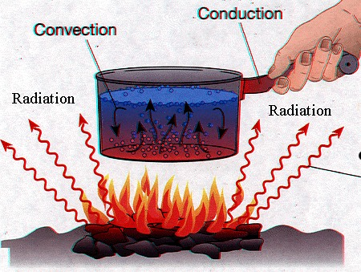
Conduction, Convection, and Radiation
Chapter 3, Lesson 4

Slide 2
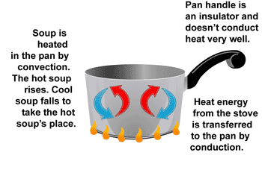
Conduction
Definition: The transfer of thermal energy by collisions between particles in matter
Heat travels along a substance from molecule to molecule (between two materials that touch each other)

Slide 3
Conductors vs. Insulators
Conductor- materials in which thermal energy moves quickly, and is transferred easily
Insulators- thermal energy moves slowly, and does not transfer easily
Examples of Conductor and Insulators…
Conductors | Insulators
Silver | Air
Copper | Styrofoam
Aluminum | Fiberglass
Steel | Cork
Brass | Wood

Slide 4
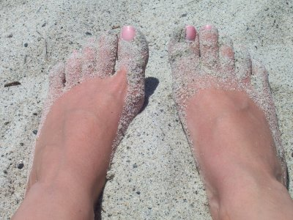
Examples of Conduction
Water heating on an electric stove
Hot sand touching your feet
Touching a stove and being burned
Ice cooling down your hand

Slide 5
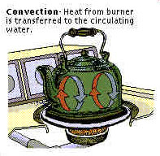
Convection
Definition: The transfer of thermal energy by the movement of matter from one place to another
Fluid- material made of particles that can easily change their locations
Only occurs in liquids and gases
Heat transfer by a circulation of rising warm air (less dense) and sinking cooler air (denser).
“Hot air rises” the more dense air sinks forcing the less dense air upward

Slide 6
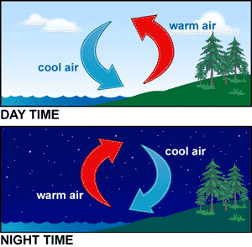
Convection Currents
Definition: The circular motion that results in a fluid heated from below
A hot-air balloon rises as the air inside is heated, and sinks when the air inside cools.

Slide 7
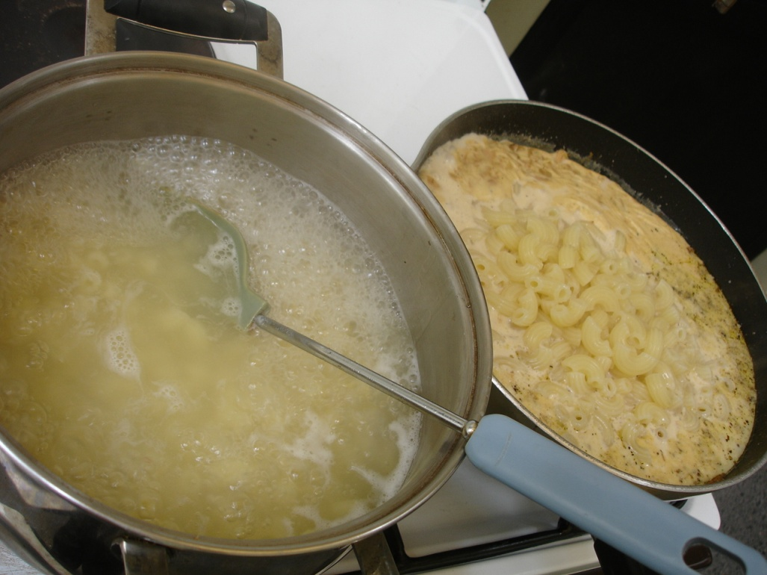
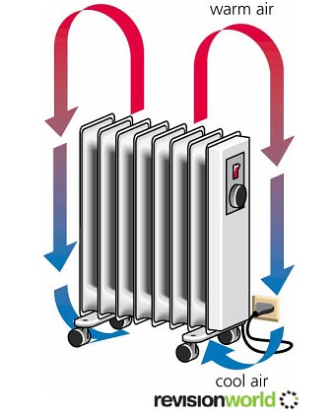
Convection Examples
Hot-air balloon
Macaroni rising and falling in a pot of heated water
An old-fashioned radiator (creates a convection cell in a room by emitting warm air at the top and drawing in cool air at the bottom)

Slide 8
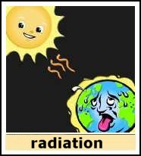
Radiation
Definition: The transfer of thermal energy by electromagnetic waves
The movement of heat in a wave-like motion through an empty space
This carries energy from the hot object and causes it to cool down.

Slide 9
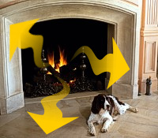
Radiation Examples
Sunlight
Heat from toaster
Heat from a light bulb
Heat from a fire
Heat from anything else which is warmer than its surroundings.

